Slide 1

Quality is never an accident. It is always the result of high intention, sincere effort, intelligent direction and skilful execution.

Slide 2
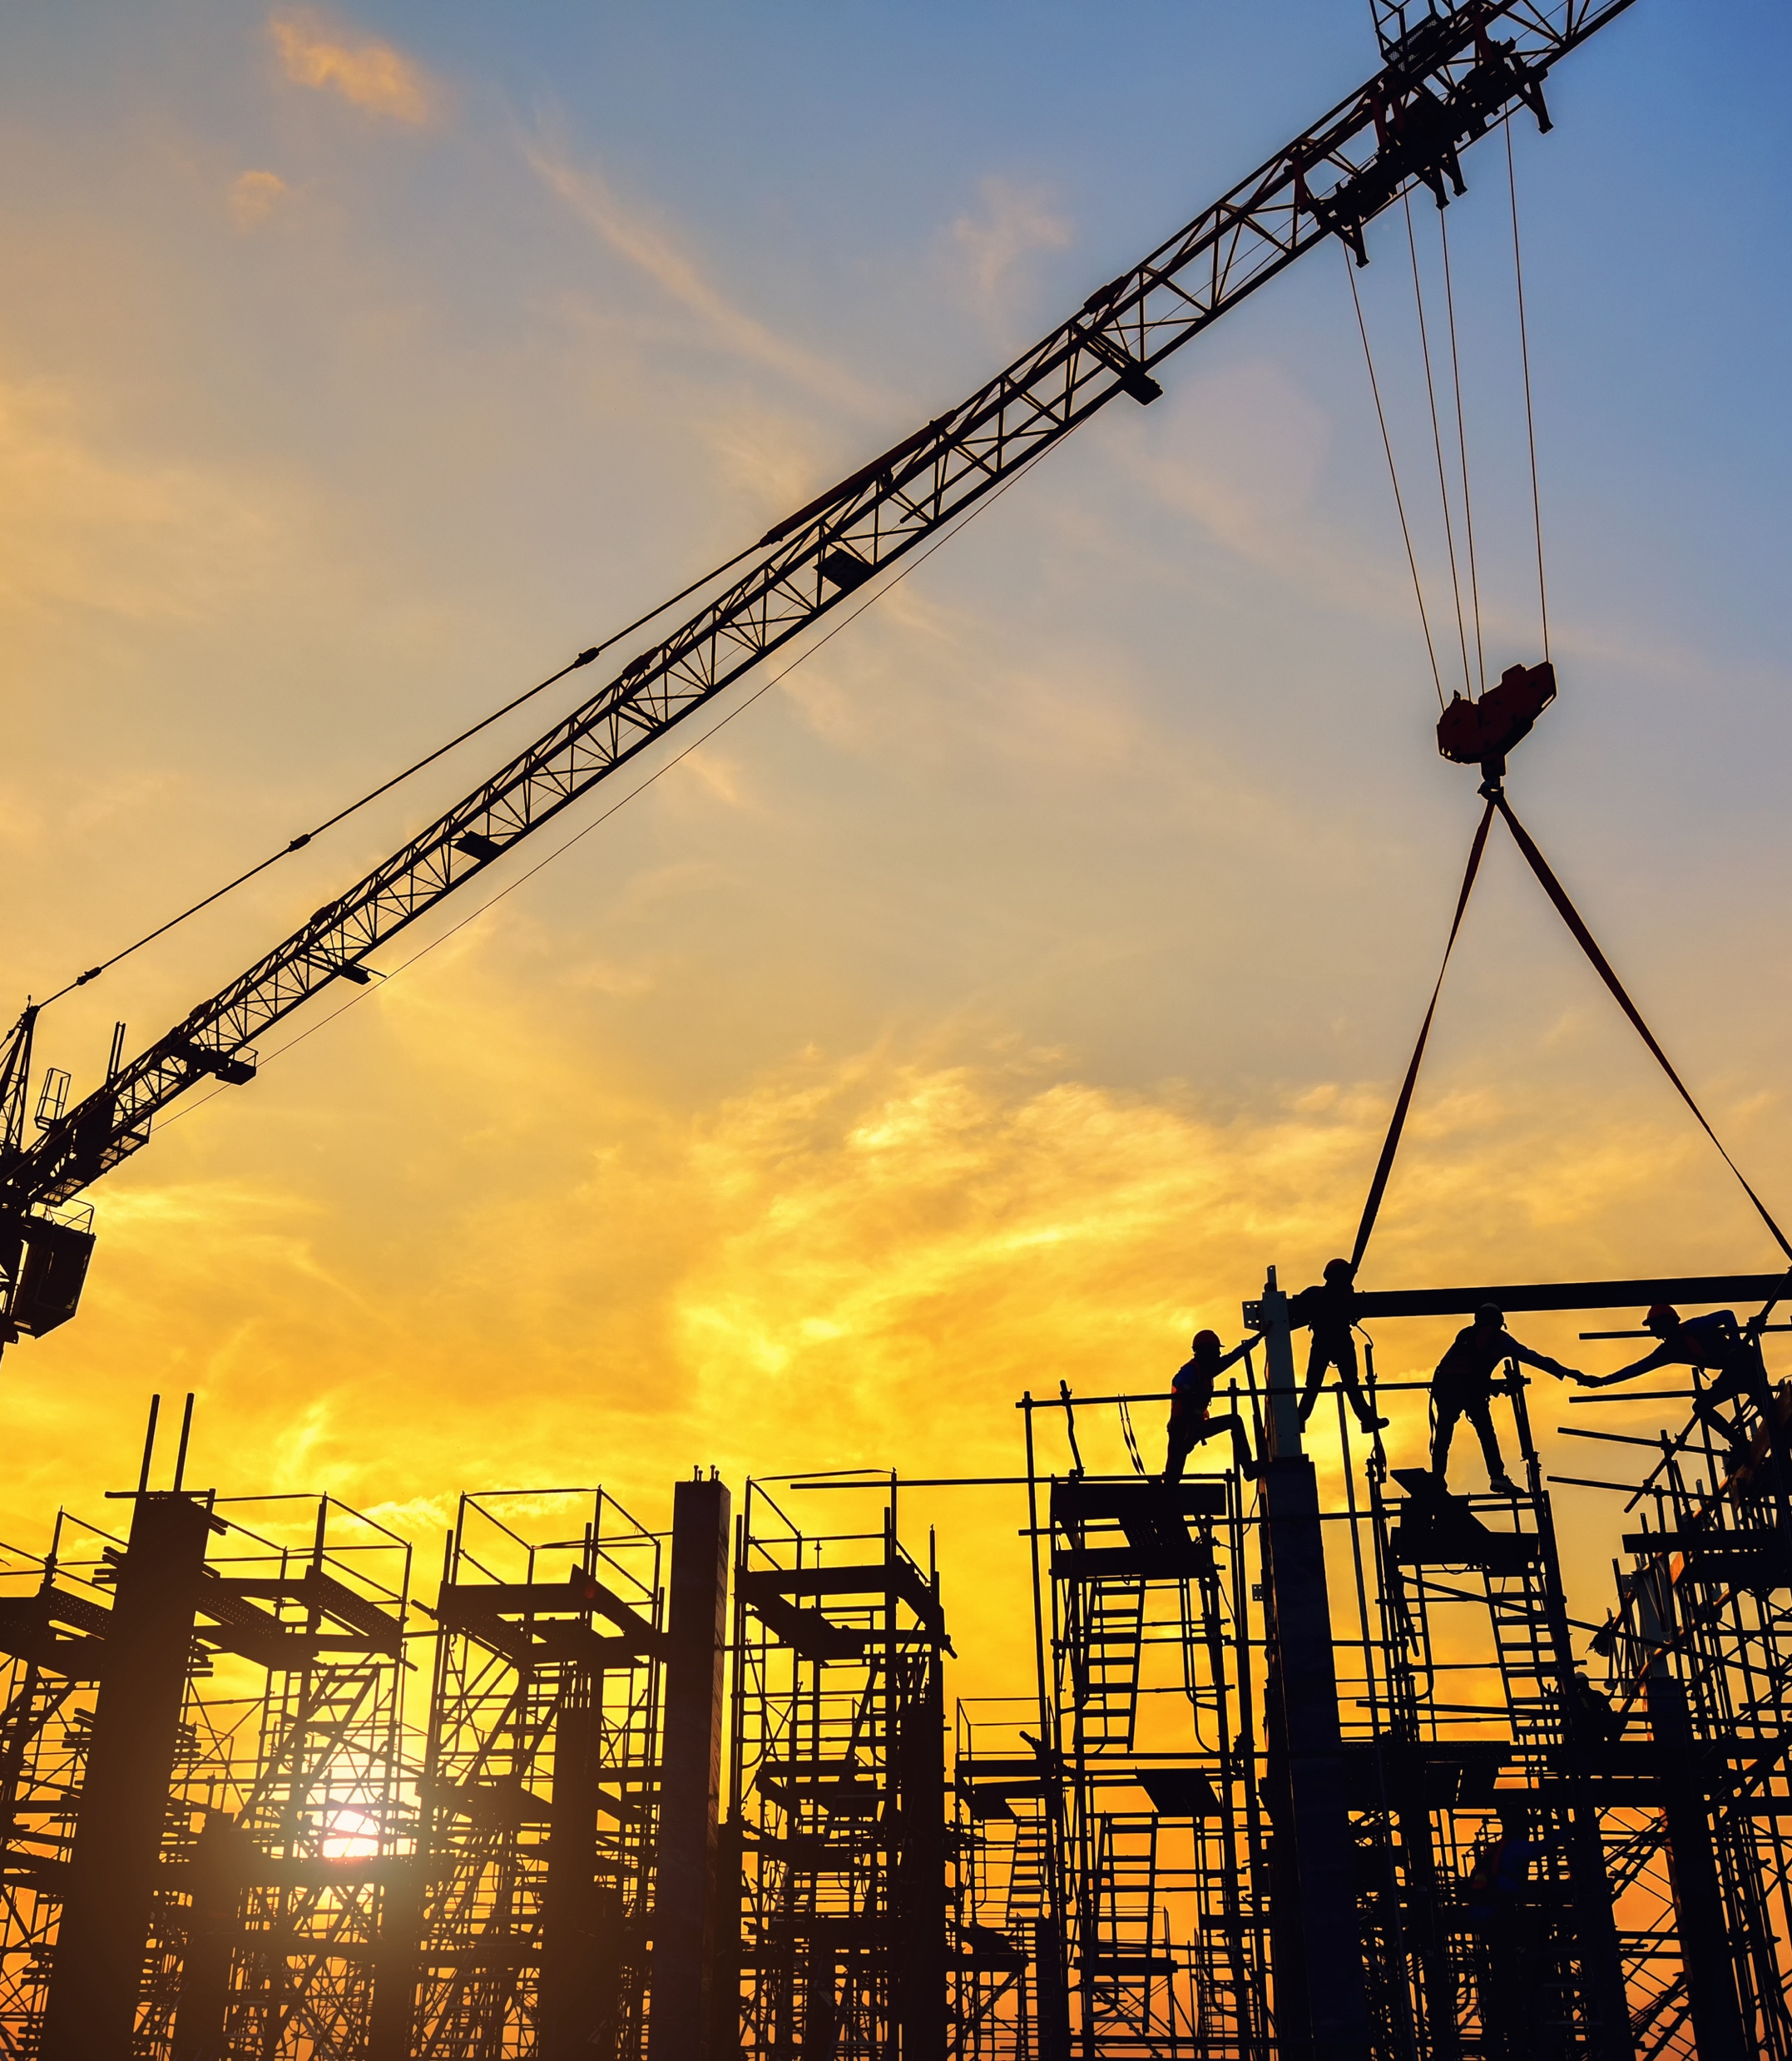

Our Legacy
We are a premier real estate company operating in the business for the past 40 years.
At Avishkar we emphasize on innovation, sustainability and quality.
During this life span the company has collaborated with other renowned firms and developers in Pune.
We have developed more than 10million sqft of residential and commercial spaces.

Slide 3

Built to suit
Designed to order- and We truly believe in that
At Avishkar we use our technical skills to save time, boost quality and reduce costs
We are among the first to execute Built-to-Suit projects, with 700,000 sqft in industrial spaces.

Slide 4
Why Choose Avishkar Realty?
Over 700,000 sqft of industrial Built-to-Suit projects successfully delivered in Pune.
Committed to eco-conscious development with an emphasis on sustainable, green-certified buildings.
Tailored solutions, budget-friendly options, and smooth implementation."
Let me know if you'd like further tweaks!

Slide 5
Why choose BUILT-TO-SUIT?
Tailored facility: Designed to enhance functionality and align with operational requirements.
Low capital investment: The developer handles both land acquisition and construction expenses, significantly lowering financial risk for the tenants.
Space Efficiency: Incorporation of cost effective and energy saving systems, reducing operational expenses.

Slide 6


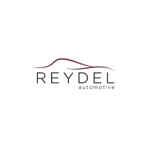





Existing clients

Slide 7

METHODOLOGY

Slide 8

1. Needs Assessment
Tenant's Requirements: specific needs, space requirements, functional needs, and aesthetic preferences.
Site Selection: Identification of suitable sites that meets the requirement and zoning regulations.
Feasibility Study: A detailed analysis is conducted to assess the project's financial viability, technical feasibility, and legal compliance.

Slide 9

2. Letter of intent
Purpose: Clearly state the primary goal of the intended agreement.
Scope: Define the specific areas of cooperation or transaction.
Timeline: Set forth a tentative timeline for key milestones and deadlines.
Amounts payable
Confidentiality: Address any confidentiality or non-disclosure agreements.
Exclusivity: Specify if the parties will be exclusive or non-exclusive in their dealings.
Governing Law: Indicate the jurisdiction that will govern the agreement.
Dispute Resolution: Outline the preferred method for resolving any disputes.

Slide 10
3. Lease Negotiation and Execution:
Lease Terms: The landlord and tenant negotiate the terms of the lease agreement, including lease duration, rental rates, and maintenance responsibilities.
Lease Execution: The lease agreement is finalized and executed by both parties.
Transfer of Deposit
Exchange of token- depositExchange of token- deposit

Slide 11

4. Design and Planning:
Architectural Design: Architects create detailed designs based on the tenant's specifications, incorporating factors like building codes, energy efficiency, and accessibility standards.
Engineering Design: Engineers design the building's structural, mechanical, electrical, and plumbing systems.
Permitting and Approvals: The necessary permits and approvals are obtained from local authorities.

Slide 12
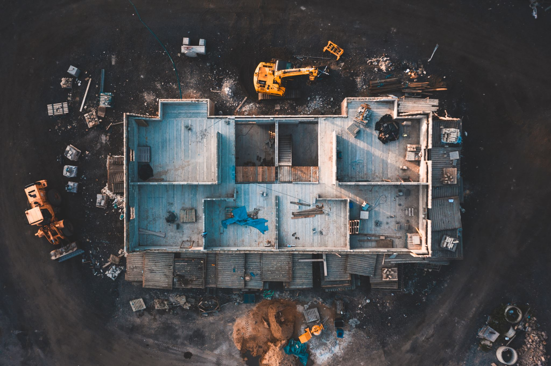
5. Construction:
Site Preparation: The site is prepared for construction, including clearing, grading, and utility connections.
Construction Phase: The building is constructed according to the approved design and construction plans.
Quality Control: Quality control measures are implemented throughout the construction process to ensure compliance with standards and specifications.

Slide 13

6. Tenant Improvement:
Interior Design: The interior space is designed to meet the tenant's specific needs, including layout, finishes, and furnishings.
Construction and Installation: Interior construction and installation of fixtures, equipment, and systems are completed.

Slide 14
7. Project Closeout and Occupancy:
Final Inspections: Final inspections are conducted to ensure the building meets all requirements and is ready for occupancy.
Handover: The building is handed over to the tenant, who assumes responsibility for operations and maintenance.

Slide 15

Value added services
Annual Maintenance Contracts- Ongoing support for building maintenance, ensuring all systems operate smoothly and preventing potential issues from becoming costly repairs. These contracts cover everything from HVAC to plumbing and electrical systems.
On-Demand Infrastructure Updates- Tailored upgrades and enhancements to meet evolving business needs. Whether it's expanding facilities or implementing the latest technological advancements, Avishkar Realty provides custom solutions as required.
Energy Efficiency Solutions- Incorporating sustainable technologies such as solar power and energy-efficient lighting systems to reduce operational costs and environmental impact. These solutions are part of the company’s commitment to green-certified buildings.
Space Optimization and Design Customization- Flexible layout designs to maximize space utilization according to the client’s operational needs. This ensures efficiency in every square foot of the building.

Slide 16



Thank you https://avishkarrealty.com/
Address: Camp Nucleus Mall, Office No.T-7, Pune - 411001.

